Slide 1


Null Team
Brought to you by: - Mohamed Ayman
- Abdelrahman Ahmed
- Anwer Amer
- Yousef MOhamed
Under the supervision of: AST - Acict

Slide 2
Introduction
Overview: The Null Cars Project is a
comprehensive online car rental platform designed for users to easily browse, reserve, and manage car rentals.
Objective: Provide a seamless experience for both users and admins with efficient booking and management functionalities.
Tech Stack: Built using React, Firebase, and Bootstrap for a modern, responsive interface.

Slide 3
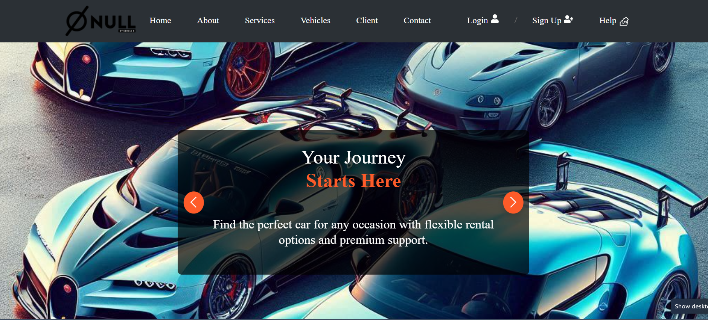
Home

Slide 4
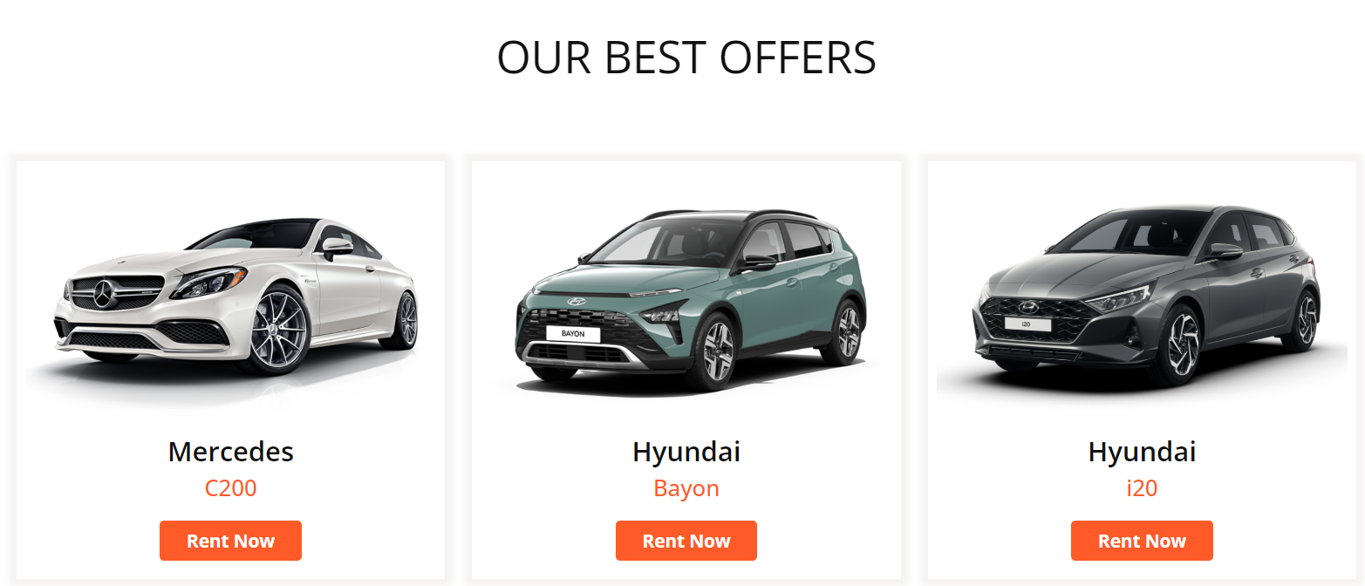
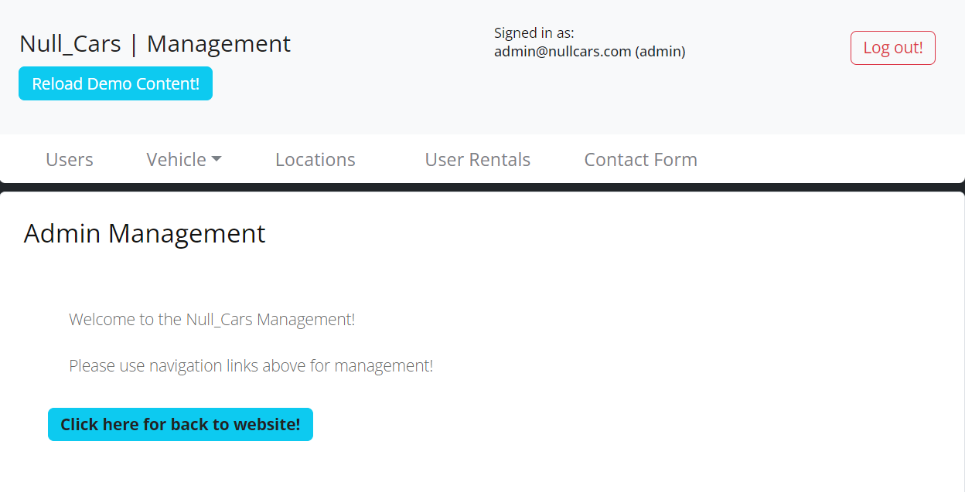
Core Features
Car Listings: Users can browse a variety of vehicles for rent with detailed information.
Booking System: Easy-to-use booking system that tracks availability and confirms reservations.
User Authentication: Secure login and registration powered by Firebase.
Admin Panel: Manage car inventory, monitor user activity, and update rental data.

Slide 5
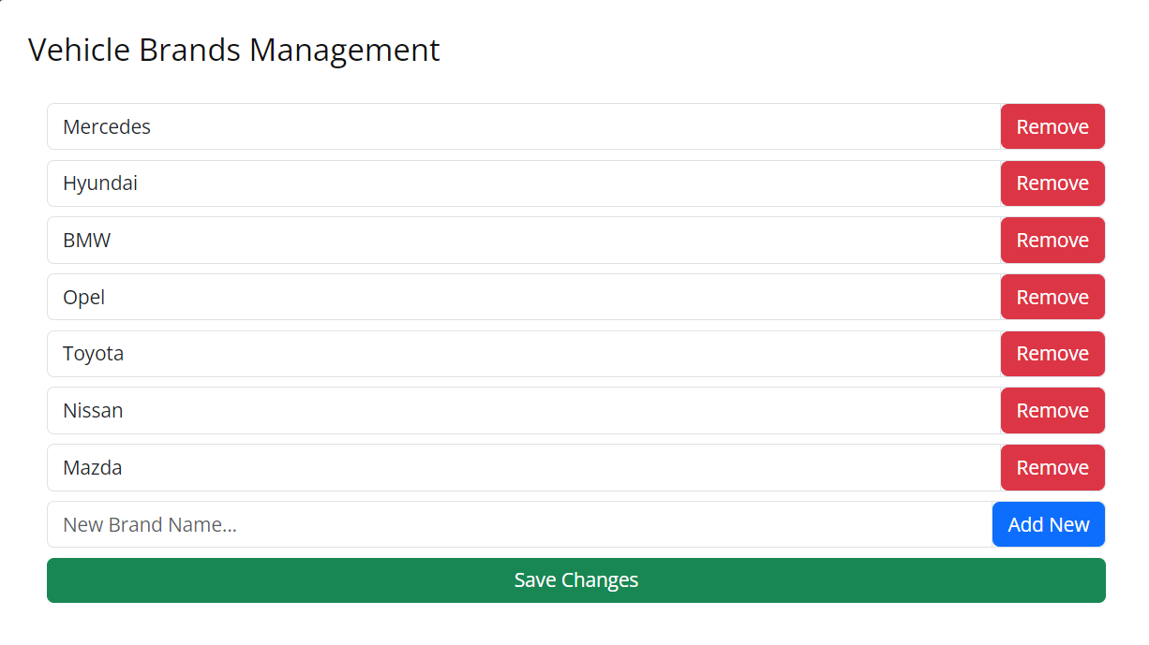
UI/UX & Admin Panel
User Experience:
Designed for ease of use, with a straightforward interface for non-technical users.
- Admin Capabilities:
Add, update, or remove cars from the system.
Monitor all bookings, ensuring up-to-date availability.
manage vehicle brands by adding, editing, or removing them.

Slide 6
Challenges and Solutions
Challenge 1: real-time data integration.
Solution: Organized Firebase collections to make reading and writing data faster, improving load times.
Challenge 2: Ensuring responsive design across devices.
Solution: Used React Bootstrap for all devices
approach.

Slide 7
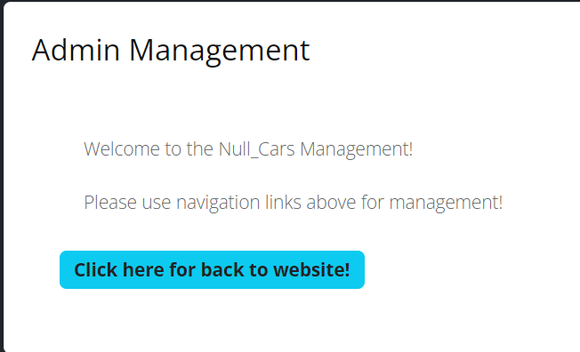
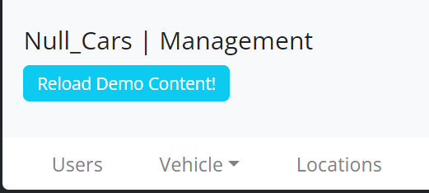
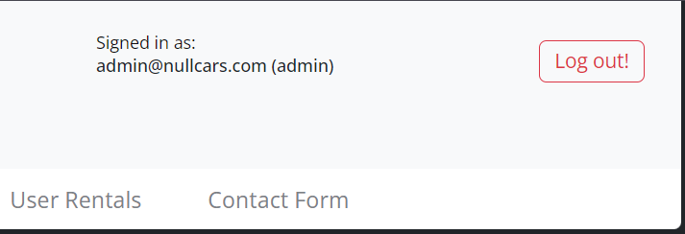
Mohamed Ayman
Admin Dashboard Interface:
Welcome message for the admin: "Welcome to the Null_Cars Management.“
navigation button for users to go back to the main website.
Admin Navigation Bar:
Dynamic header with options for managing users, vehicles, locations, rentals, and more.
logout button for easy session management.
reset option with a confirmation dialog to restore demo content, utilizing Firebase for database updates.

Slide 8
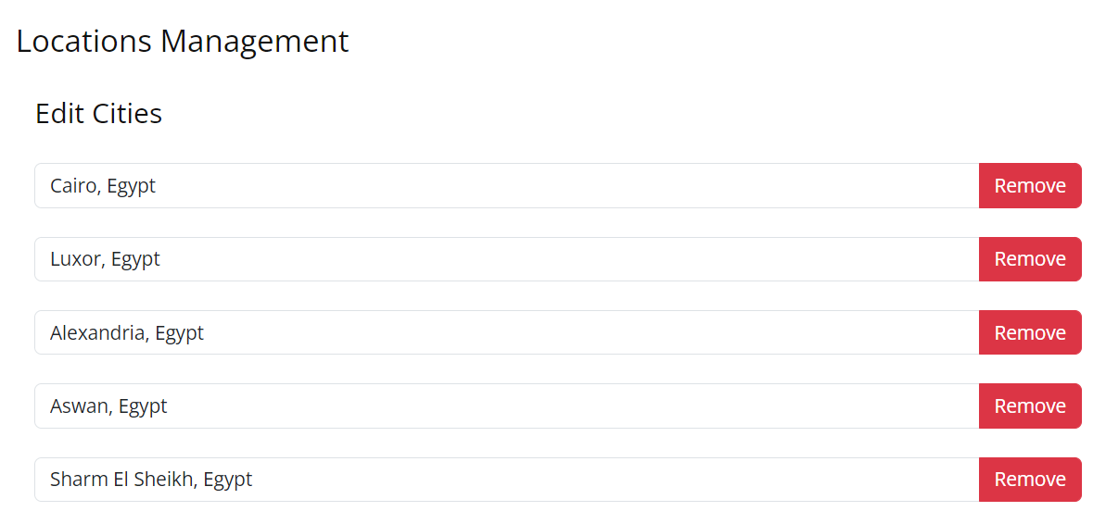
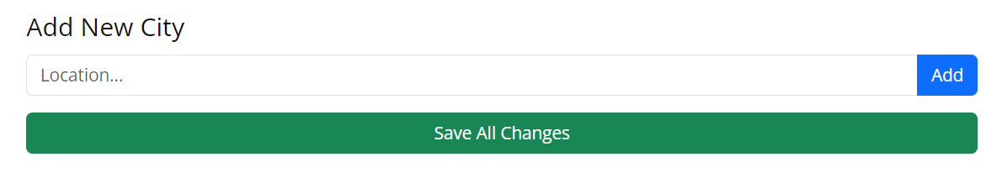
Mohamed Ayman
Locations Management:
List of locations with add/edit functionality.
Real-time data updates.
reset option with a confirmation dialog to restore demo content, utilizing Firebase for database updates.

Slide 9
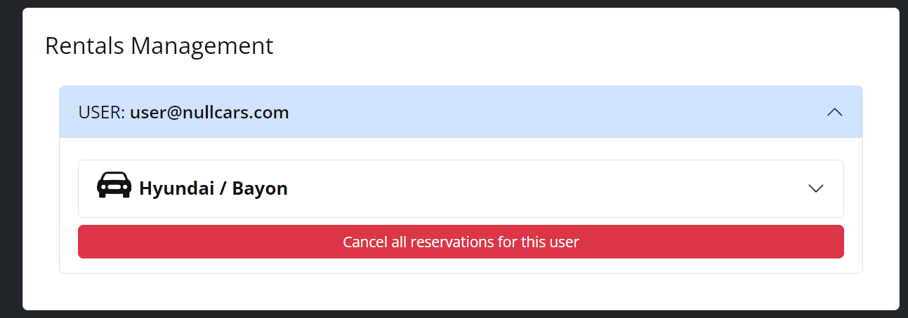
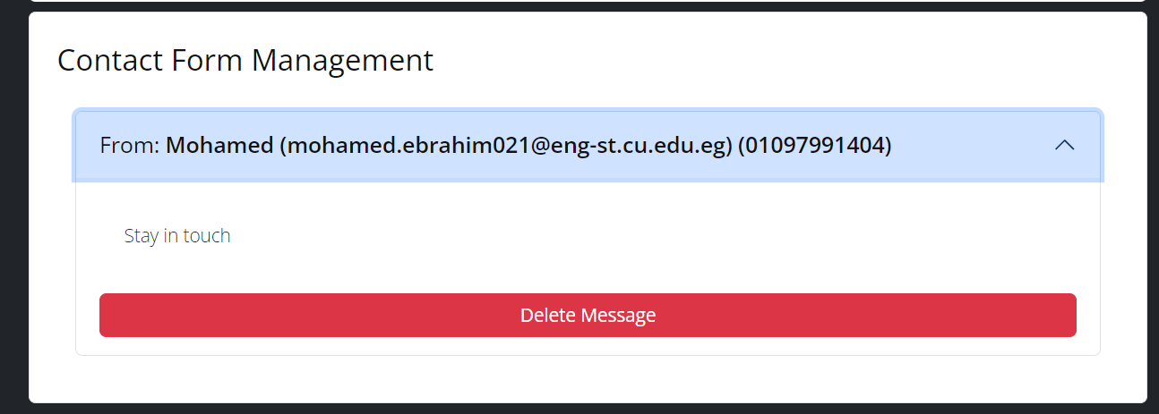
Mohamed Ayman
Rentals Management:
Admin can cancel individual or all reservations for a user.
Provides detailed car specs (engine, gearbox, body type) and reservation details (pickup/drop-off locations, start/end dates).
Contact-Form Management:
delete functionality with a confirmation alert using Sweet Alert.
Real-time updates of the contact forms list upon deletion.

Slide 10
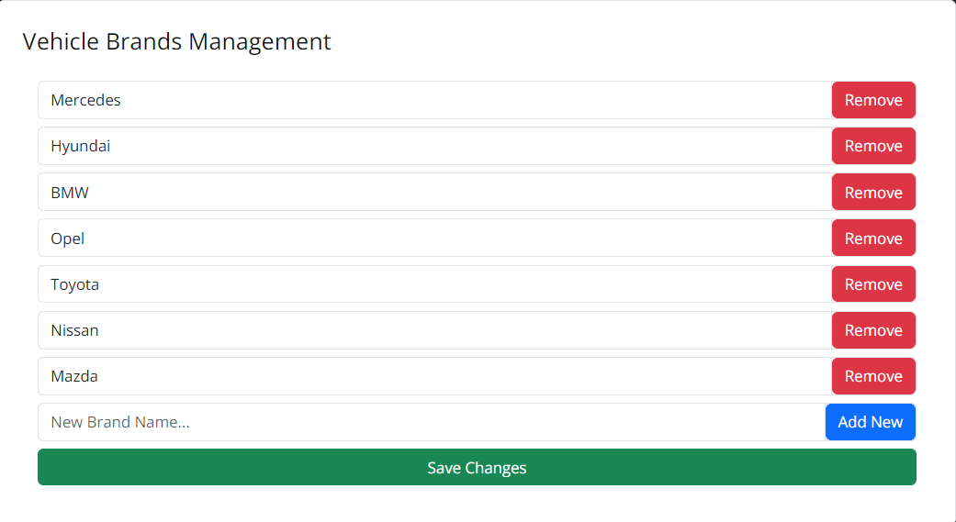
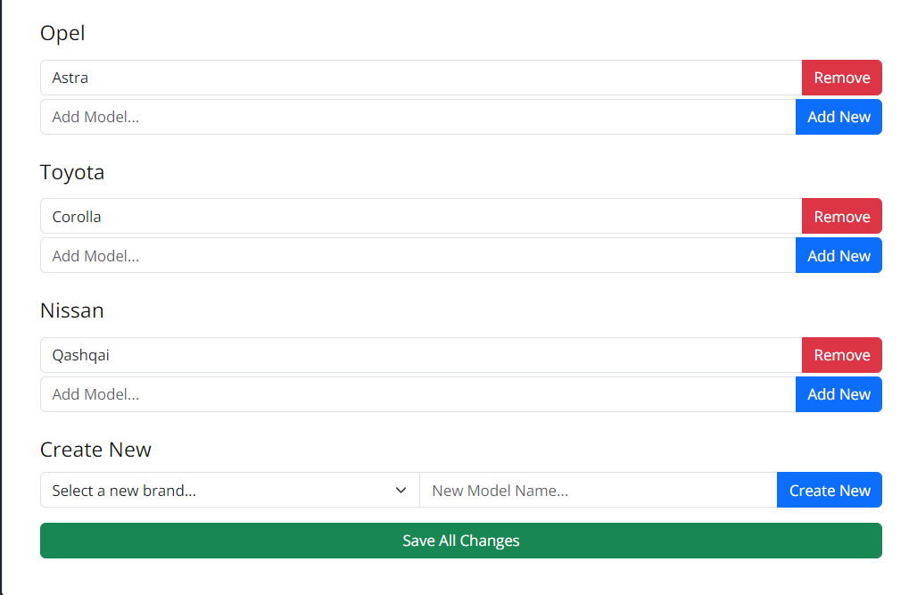
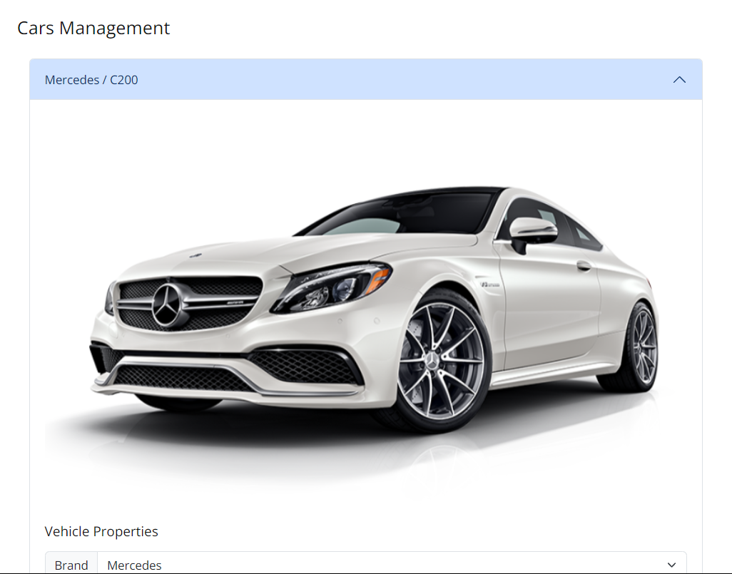
Abdelrhman Ahmed
Vehicle Brands Management Overview:
Vehicle Brands Management :
Add, remove, or edit brand names and save changes in real-time.
Vehicle Models Management :
Add models to existing brands, create new models, edit, or remove them.
Save changes efficiently.
Cars Management:
View, edit, add, or remove car details on a user-friendly page.
Use the Edit All feature to bulk update data.
Key Functionalities:
Add, edit, remove entries for brands, models, and cars.
Real-time data persistence and smooth user experience.

Slide 11
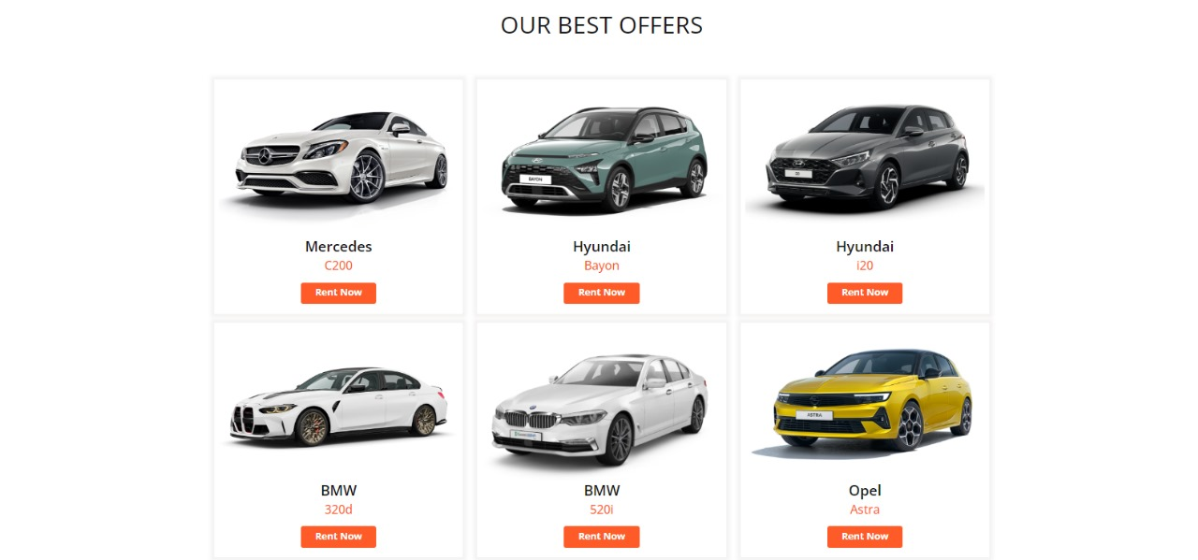
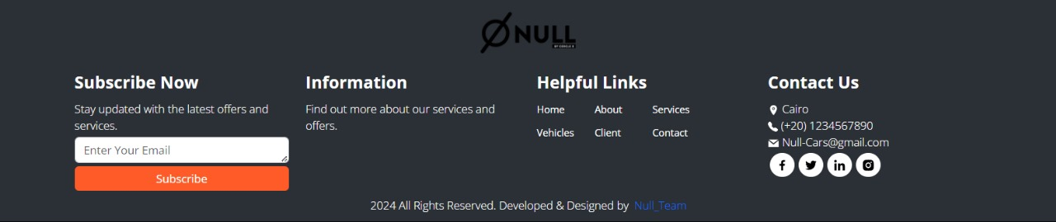
Anwar amer
Component Management:
Design, edit, and manage various UI components.
Ensure consistency and real-time updates across the application.
Configure Management:
Configure settings to optimize application performance.
Centralize and manage configuration files for better scalability.

Slide 12
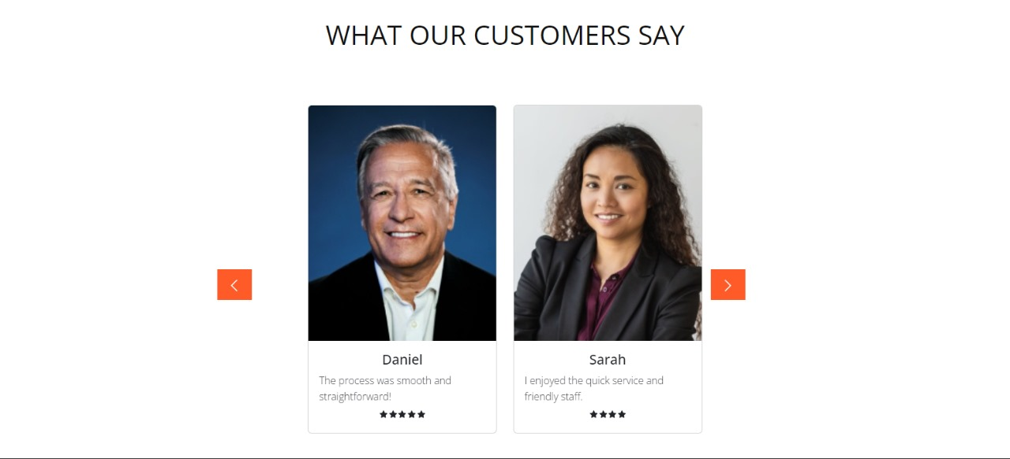
Anwar amer
Data and Redux:
Manage global state with Redux, ensuring smooth data flow.
Implement data persistence and efficient data handling throughout the app.
Utilitys Functions:
Create utility functions for code reusability and cleaner code.
Streamline app functionality with shared utility functions.

Slide 13
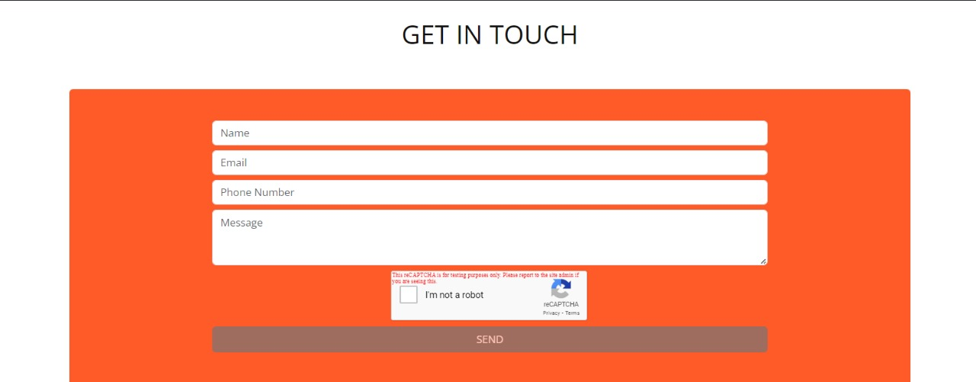

Anwar amer
App.js:
Serve as the entry point for the application.
Manage routing and integrate components for seamless user navigation.
Key Functionalities:
Design, configure, and manage components and configurations.
Ensure smooth data management and state handling with Redux.
Implement utilities to enhance code efficiency.
Centralize application flow in App.js for optimal user experience.

Slide 14
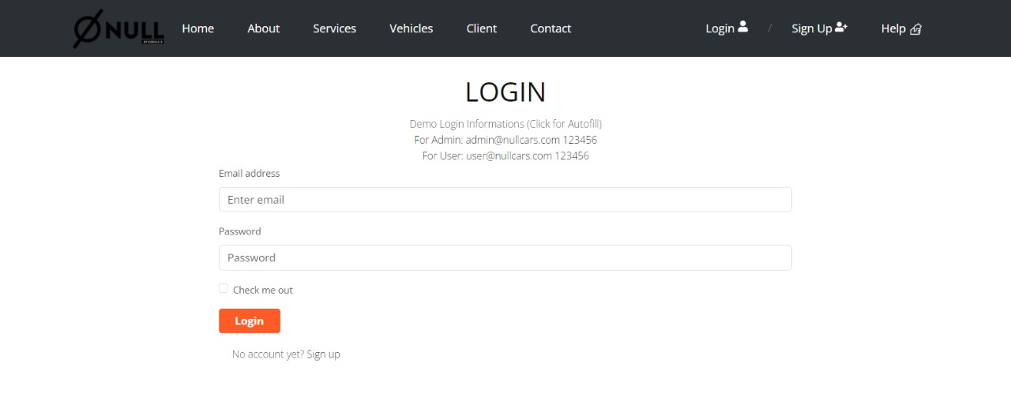
Yosef m.Ali
Login page :
Tools Used
HTML/CSS: For designing the page interface.
JavaScript: For adding interactivity.
Firebase: For data storage and user management.
User Interface Design
The design includes components such as input fields (email and password) and a login button.
Connecting to Firebase
Create a new project in Firebase.
Set up Firebase configuration (API Key, Auth Domain, etc.).
Add the Firebase library to the project.
Testing the Page
Ensure that the login process works correctly and review error or success messages.

Slide 15
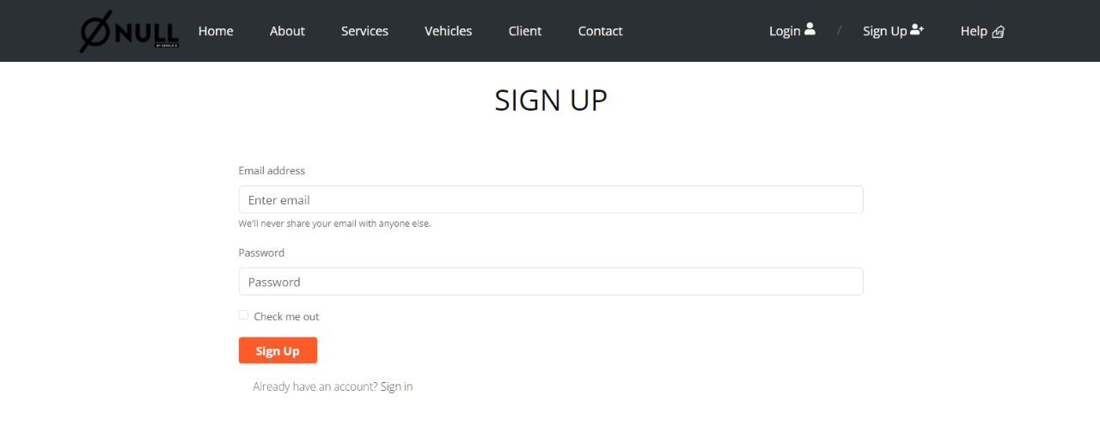
Yosef m.ali
Sign up page :
Tools Used
HTML/CSS: For designing the page interface.
JavaScript: For adding interactivity.
Firebase: For data storage and user management.
User Interface Design
The design includes components such as input fields (name, email, password) and a sign-up button.
Connecting to Firebase
Create a new project in Firebase.
Set up Firebase configuration (API Key, Auth Domain, etc.).
Add the Firebase library to the project.
Testing the Page
Ensure that the sign-up process works correctly and review error or success message

Slide 16

Yosef m.ali
Collecting data and images :
Data Formatting: Organize data in an easily accessible manner.
Image Design: Choose high-quality images that fit the website content.
Professional Image Collection
Image Sources: Use reliable websites to obtain royalty-free images.
Image Optimization: Use tools to enhance image quality and size for the web.
Testing and Analyzing Results
Performance Testing: Ensure data and images load quickly.
Experience Analysis: Evaluate how users interact with the site based on collected data.

Slide 17

Any Questions ?

Slide 18
Thank you

